Slide 1


Slide 2
Introduction
A transaction processing system.
Supports Requester-Server approach.
Presentation services are located in requester program and database logic resides in server program.
Provides programs and environment to support OLTP on Tandem system.
Notes:
The Pathway subsystem includes a group of related software tools that enable your organization to develop, install, and manage online transaction processing applications.
Transaction processing applications consist of two types of programs: requester programs (called clients in other environments) and server programs. Among other benefits, the requester/server design allows application logic to be distributed near the resources it manages. For example, presentation services are located in requester programs near the I/O devices; database logic resides in server programs near the database. Requesters and servers communicate using the message system provided by the Tandem NonStop Kernel.
Link managers (such as terminal control processes (TCPs) and NonStop TS/MP LINKMON processes) coordinate the sharing of links between the requester and server processes. The PATHMON process, in addition to creating, configuring, and globally managing server classes, grants links to link managers that request access to server processes.
Users interact with your application by using devices and processes controlled by your requester programs. Often these devices are terminals through which users enter and retrieve transaction data. They might also be intelligent devices such as PCs, workstations, point-of-sale devices, or automated teller machines (ATMs).
[Pathway/TS Management Programming Manual]
[Pathway/TS TCP and Terminal Programming Guide]

Slide 3
Components of Pathway
PATHMON
PATHCOM
TCP
SERVER PROCESS
SERVER CLASS
SCREEN COBOL LIBRARY
TERM and PROGRAM
LINKMON

Slide 4
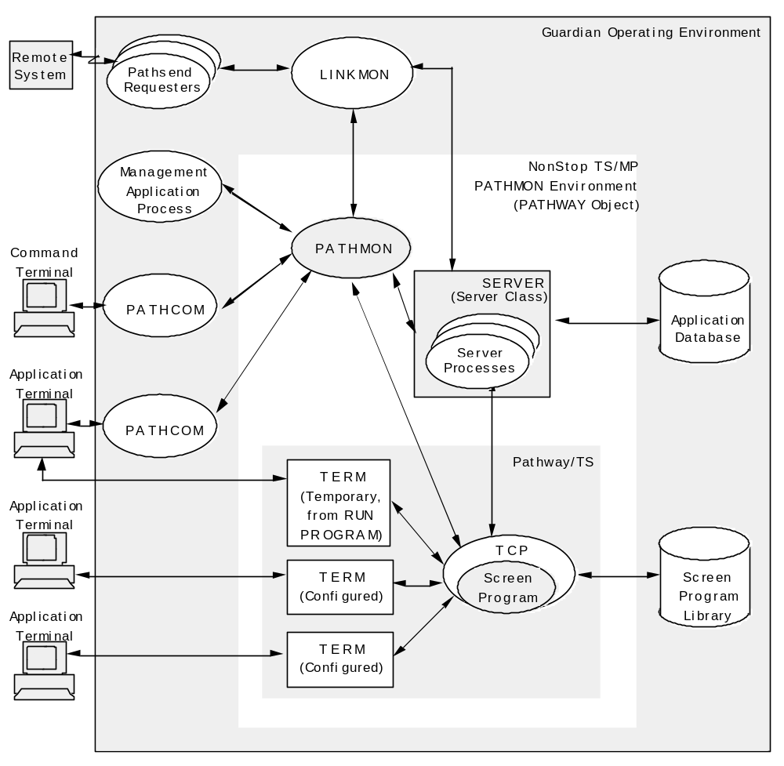

Slide 5
PATHMON
  It is the supervising process that manages all other processes running in the Pathway system.
  Maintains a record of the object definitions in a control file.
  Grants communication links between TCP and servers.
Notes:
You can use PATHCOM at a command terminal to communicate interactively with the PATHMON process. Other users use PATHCOM at application terminals to start and run PATHWAY applications. Multiple PATHCOM processes can communicate with a single PATHMON process concurrently.
[Pathway/TS System Management Manual]

Slide 6
PATHCOM
  An interactive interface to PATHMON process.
  Provides a set of commands for defining and managing the Pathway environment.
    Configures server objects
    Starts and stops server objects
    Obtain status information
Notes:
You can use PATHCOM at a command terminal to communicate interactively with the PATHMON process. Other users use PATHCOM at application terminals to start and run PATHWAY applications. Multiple PATHCOM processes can communicate with a single PATHMON process concurrently.
[Pathway/TS System Management Manual]

Slide 7
TERMINAL CONTROL PROCESS (TCP)
  Executes the SCREEN COBOL programs in your application.
  Coordinates communication between screen program, server programs, and the PATHMON process.
  Multithreaded process.
Notes:
A Terminal Control Process (TCP) interprets and executes screen program instructions for each input-output (I/O) device or process the TCP is configured to handle. The TCP coordinates communication between screen programs and their I/O devices or processes and, with the help of PATHMON process, establishes links between the screen programs and server processes. The TCP also performs the following tasks:
Verifies and stores terminal context data and terminal control logic.
Gathers statistics about TERM objects, the server processes, and itself.
Reports operating errors and status information to the PATHMON process.
Provides integrity across failure situations.
Because it is a multithreaded process, a TCP can concurrently manage many user terminals and execute many screen programs. To accomplish these tasks, the TCP runs its TERM or PROGRAM objects as threads, interleaving the concurrent processing of requests originating from many I/O devices or processes. This multithreading allows the TCP to handle complex groups of operations for many users at the same time.
In addition to managing operation of terminals, the TCP supports card readers, local printers, and bar-code readers when they are attached to terminals.
[Pathway/TS System Management Manual]

Slide 8
SERVER PROCESS
  An executing server program is called a server process.
  Handles IPC for one or more services.
  Receives the requests, perform database I/O functions, and return appropriate replies to the TCP.
Notes:
A Terminal Control Process (TCP) interprets and executes screen program instructions for each input-output (I/O) device or process the TCP is configured to handle. The TCP coordinates communication between screen programs and their I/O devices or processes and, with the help of PATHMON process, establishes links between the screen programs and server processes. The TCP also performs the following tasks:
Verifies and stores terminal context data and terminal control logic.
Gathers statistics about TERM objects, the server processes, and itself.
Reports operating errors and status information to the PATHMON process.
Provides integrity across failure situations.
Because it is a multithreaded process, a TCP can concurrently manage many user terminals and execute many screen programs. To accomplish these tasks, the TCP runs its TERM or PROGRAM objects as threads, interleaving the concurrent processing of requests originating from many I/O devices or processes. This multithreading allows the TCP to handle complex groups of operations for many users at the same time.
In addition to managing operation of terminals, the TCP supports card readers, local printers, and bar-code readers when they are attached to terminals.
[Pathway/TS System Management Manual]

Slide 9
SERVER CLASS
  A group of identical server processes created from the same object file on the disk is called a server class.
  A server class is, therefore, a group of server processes that perform a specific type of application work.
Notes:
A Terminal Control Process (TCP) interprets and executes screen program instructions for each input-output (I/O) device or process the TCP is configured to handle. The TCP coordinates communication between screen programs and their I/O devices or processes and, with the help of PATHMON process, establishes links between the screen programs and server processes. The TCP also performs the following tasks:
Verifies and stores terminal context data and terminal control logic.
Gathers statistics about TERM objects, the server processes, and itself.
Reports operating errors and status information to the PATHMON process.
Provides integrity across failure situations.
Because it is a multithreaded process, a TCP can concurrently manage many user terminals and execute many screen programs. To accomplish these tasks, the TCP runs its TERM or PROGRAM objects as threads, interleaving the concurrent processing of requests originating from many I/O devices or processes. This multithreading allows the TCP to handle complex groups of operations for many users at the same time.
In addition to managing operation of terminals, the TCP supports card readers, local printers, and bar-code readers when they are attached to terminals.
[Pathway/TS System Management Manual]

Slide 10
SCREEN COBOL LIBRARY
  The SCREEN COBOL compiler compiles the SCREEN COBOL requester programs and generates pseudo-object files (POBJDIR, POBJCOD, and POBJSYM).
  These pseudocodes are interpreted and executed by the TCP.
Notes:
A Terminal Control Process (TCP) interprets and executes screen program instructions for each input-output (I/O) device or process the TCP is configured to handle. The TCP coordinates communication between screen programs and their I/O devices or processes and, with the help of PATHMON process, establishes links between the screen programs and server processes. The TCP also performs the following tasks:
Verifies and stores terminal context data and terminal control logic.
Gathers statistics about TERM objects, the server processes, and itself.
Reports operating errors and status information to the PATHMON process.
Provides integrity across failure situations.
Because it is a multithreaded process, a TCP can concurrently manage many user terminals and execute many screen programs. To accomplish these tasks, the TCP runs its TERM or PROGRAM objects as threads, interleaving the concurrent processing of requests originating from many I/O devices or processes. This multithreading allows the TCP to handle complex groups of operations for many users at the same time.
In addition to managing operation of terminals, the TCP supports card readers, local printers, and bar-code readers when they are attached to terminals.
[Pathway/TS System Management Manual]

Slide 11
TERM and PROGRAM
  TERM: Task controlling INPUT/OUTPUT device that allow the users to interact with Pathway application.
  PROGRAM: Template to create a temporary terminals.
Notes:
A Terminal Control Process (TCP) interprets and executes screen program instructions for each input-output (I/O) device or process the TCP is configured to handle. The TCP coordinates communication between screen programs and their I/O devices or processes and, with the help of PATHMON process, establishes links between the screen programs and server processes. The TCP also performs the following tasks:
Verifies and stores terminal context data and terminal control logic.
Gathers statistics about TERM objects, the server processes, and itself.
Reports operating errors and status information to the PATHMON process.
Provides integrity across failure situations.
Because it is a multithreaded process, a TCP can concurrently manage many user terminals and execute many screen programs. To accomplish these tasks, the TCP runs its TERM or PROGRAM objects as threads, interleaving the concurrent processing of requests originating from many I/O devices or processes. This multithreading allows the TCP to handle complex groups of operations for many users at the same time.
In addition to managing operation of terminals, the TCP supports card readers, local printers, and bar-code readers when they are attached to terminals.
[Pathway/TS System Management Manual]

Slide 12
LINKMON
  It is the process which manages the communication between the server processes and the PATHSEND requesters.
Notes:
A Terminal Control Process (TCP) interprets and executes screen program instructions for each input-output (I/O) device or process the TCP is configured to handle. The TCP coordinates communication between screen programs and their I/O devices or processes and, with the help of PATHMON process, establishes links between the screen programs and server processes. The TCP also performs the following tasks:
Verifies and stores terminal context data and terminal control logic.
Gathers statistics about TERM objects, the server processes, and itself.
Reports operating errors and status information to the PATHMON process.
Provides integrity across failure situations.
Because it is a multithreaded process, a TCP can concurrently manage many user terminals and execute many screen programs. To accomplish these tasks, the TCP runs its TERM or PROGRAM objects as threads, interleaving the concurrent processing of requests originating from many I/O devices or processes. This multithreading allows the TCP to handle complex groups of operations for many users at the same time.
In addition to managing operation of terminals, the TCP supports card readers, local printers, and bar-code readers when they are attached to terminals.
[Pathway/TS System Management Manual]

Slide 13
PATHSEND
  Pathsend requesters (also called Pathsend processes) are requesters written in languages other than SCREEN COBOL that use the Pathsend procedure calls to access Pathway server classes.
Notes:
A Terminal Control Process (TCP) interprets and executes screen program instructions for each input-output (I/O) device or process the TCP is configured to handle. The TCP coordinates communication between screen programs and their I/O devices or processes and, with the help of PATHMON process, establishes links between the screen programs and server processes. The TCP also performs the following tasks:
Verifies and stores terminal context data and terminal control logic.
Gathers statistics about TERM objects, the server processes, and itself.
Reports operating errors and status information to the PATHMON process.
Provides integrity across failure situations.
Because it is a multithreaded process, a TCP can concurrently manage many user terminals and execute many screen programs. To accomplish these tasks, the TCP runs its TERM or PROGRAM objects as threads, interleaving the concurrent processing of requests originating from many I/O devices or processes. This multithreading allows the TCP to handle complex groups of operations for many users at the same time.
In addition to managing operation of terminals, the TCP supports card readers, local printers, and bar-code readers when they are attached to terminals.
[Pathway/TS System Management Manual]

Slide 14
PATHCTL
  It is a disk file in which the PATHMON process maintains the configuration information about the objects under its control.
Notes:
A Terminal Control Process (TCP) interprets and executes screen program instructions for each input-output (I/O) device or process the TCP is configured to handle. The TCP coordinates communication between screen programs and their I/O devices or processes and, with the help of PATHMON process, establishes links between the screen programs and server processes. The TCP also performs the following tasks:
Verifies and stores terminal context data and terminal control logic.
Gathers statistics about TERM objects, the server processes, and itself.
Reports operating errors and status information to the PATHMON process.
Provides integrity across failure situations.
Because it is a multithreaded process, a TCP can concurrently manage many user terminals and execute many screen programs. To accomplish these tasks, the TCP runs its TERM or PROGRAM objects as threads, interleaving the concurrent processing of requests originating from many I/O devices or processes. This multithreading allows the TCP to handle complex groups of operations for many users at the same time.
In addition to managing operation of terminals, the TCP supports card readers, local printers, and bar-code readers when they are attached to terminals.
[Pathway/TS System Management Manual]

Slide 15
Pathway Configuration and Operation

Slide 16
Starting PATHMON
A PATHMON process can be started with a simple command on TACL prompt:
> PATHMON / NAME $xxxx, CPU n, NOWAIT, OUT xyz /

Slide 17
Starting PATHCOM
A PATHCOM process can be started with a simple command on TACL prompt:
> PATHCOM $xxxx

Slide 18
IN Command
> PATHCOM / IN $volme.subvolume.config,
OUT $S.#list, CPU 2, NOWAIT / $xxxx

Slide 19
Types of starting PATHMON environment
COLD start
Starting a new PATHMON environment,
which creates new PATHCTL file.
COOL start
  Restarting an existing PATHMON
  environment, with the same earlier
  configuration stored in PATHCTL file.

Slide 20
Global Parameters

Slide 21
Global Parameters
MAXASSIGNS
  Maximum number of Assign definitions that can be
  specified for all server classes.
MAXPARAMS
  Maximum number of PARAM messages that can be
  specified for all server classes.
MAXDEFINES
  Maximum number of DEFINEs that can be specified
  for objects.

Slide 22
Global Parameters Cont.
MAXSERVERCLASSES
  Maximum number of server classes that can be
  added to the PAHMON configuration.
MAXSERVERPROCESSES
  Maximum number of server processes that can be
  added to the PATHMON configuration and started.

Slide 23
Global Parameters Cont.
MAXLINKMONS
  Maximum number of LINKMONs that the PATHMON can handle.
MAXPROGRAMS
  Maximum number of PROGRAM objects that can be
  added.
MAXTERMS
  Maximum number of TERM objects that can be
  added.

Slide 24
Global Parameters Cont.
MAXSTARTUPS
  Maximum number of server classes that can have
  startup messages.
MAXTPATHCOMS
  Maximum number of PATHCOM processes that can
  run simultaneously within a PATHMON environment.

Slide 25
Configuration of TCP

Slide 26
Syntax:
RESET TCP
SET TCP CPUS 1:2
SET TCP PRI 135
SET TCP PROCESS $CT01
SET TCP MAXSERVERCLASSES 5
SET TCP MAXSERVERPROCESSES 5
SET TCP MAXTERMS 5
SET TCP TCLPROG $DATA5.NAV.POBJ
…
ADD TCP TCP-01

Slide 27
Attributes For TCP
MAXTERMS
    Maximum number of terminals that the TCP can have open at the same time.
TCLPROG
    Name of the SCREEN COBOL object library file that the TCP uses to locate the screen programs for its terminals
Notes:
MAXTERMS number
number must be a value from 0 through 4095, where 4095 is the total allowed for all PATHMON-controlled objects. A TCP opens its terminals with a syncdepth of 1. There is no default value.
TCLPROG file-name
A file name consists of all characters prefixed to the letters COD in the name under which the SCREEN COBOL program is compiled. There is no default value.
AUTORESTART number
number can be a value from 0 through 32,767. If you omit this attribute, the default is 0.

Slide 28
Attributes For TCP contd.
PRI
    Priority at which a TCP runs.
PROCESS
    Process name of the TCP when it starts.
PROGRAM
    TCP object file name
Notes:
PRI priority
priority can be a value from 1 through 199. The default is 20 less than the priority of the PATHMON process.
PROCESS $ process-name
process-name can be a maximum of 5 characters, beginning with a dollar sign ($) and followed by 1 to 4 alphanumeric characters. The first character must be a letter. The default is in the format $Znnn.
PROGRAM file-name
The default is $SYSTEM.SYSTEM.PATHTCP2.

Slide 29
Attributes For TCP contd.
CPUS
    The primary and backup processors on which the TCPs run.
DEBUG
    Specifies whether a TCP enters debug mode on startup.
INSPECT
    Specifies whether you can use the Inspect program to examine the SCREEN COBOL programs
Notes:
CHECK-DIRECTORY { ON | OFF }
ON directs the TCP to check the SCREEN COBOL program directory file.
OFF directs the TCP to check its memory for a version of the called program unit.
The default is ON.
CODEAREALEN double-number
double-number can be a value from 0 through 2,147,483,647. If you omit this value, the default is 65,536 bytes. The value you assign for this attribute depends on the number and the size of the screen programs in your applications and also on the available swap space.
CPUS primary: backup
You must set the TCP NONSTOP attribute to 1 to have a backup process created. If you omit this attribute, the PATHMON process chooses a primary CPU and a backup CPU. This attribute is meaningless for single processor systems.

Slide 30
Attributes For TCP contd.
MAXSERVERCLASSES
    Maximum number of server classes with which a TCP can communicate simultaneously.
MAXSERVERPROCESSES
    Maximum number of links a TCP can have to all servers in all server classes.
Notes:
MAXREPLY bytes
The default is 2000 bytes.
The TCP uses this number and the value for the MAXTERMDATA attribute to allocate the size of the context areas (Slot 0 and Slot 1) for its terminals.
MAXSERVERCLASSES number
The default is the number of server classes specified in the SET PATHWAY command. number must be a value from 0 through 4095.
MAXSERVERPROCESSES number
The default is the number of server classes specified in the SET PATHWAY command. number must be a value from 0 through 4095.

Slide 31
Configuration of SERVER

Slide 32
Syntax:
RESET SERVER
SET SERVER CPUS 0:1
SET SERVER PROCESS $UNSS
SET SERVER DEBUG OFF
SET SERVER PRI 140
SET SERVER MAXSERVERS 3
SET SERVER NUMSTATIC 1
SET SERVER PROGRAM $DATA5.NAV.HRO
…
ADD SERVER SERVER-CSS

Slide 33
Attributes For Server
PROCESSTYPE
    Type of servers (Guardian/OSS)
AUTORESTART
    Number of times that the PATHMON attempts to restart a server process
PRI
    Priority at which the servers of this server class run.
PROGRAM
    Name of the object file to be used by the servers in this server class.
Notes:
PROCESSTYPE GUARDIAN | OSS
If you omit this attribute, the default is GUARDIAN.
AUTORESTART number
number can be a value from 0 through 32,767. If you omit this attribute, the default is 0.
CREATEDELAY number { HRS | MINS | SECS }
CREATEDELAY must be a value within one of the following ranges:
0 through 16,383 SECS
0 through 1092 MINS
0 through 18 HRS
If you omit this attribute, the default is 1 MINS.

Slide 34
Attributes For Server Contd.
DEBUG
    Specifies whether the server processes in this server class enter debug mode when starting.
HIGHPIN
    Specifies whether the server process runs at a high PIN or a low PIN.
HOMETERM
    Name of the home terminal for servers in the server class.
Notes:
DELETEDELAY number { HRS | MINS | SECS }
number must be a value within one of the following ranges:
0 through 16,383 SECS
0 through 1092 MINS
0 through 18 HRS
If you omit this attribute, the default is 10 MINS.
DEBUG { ON | OFF }
ON - directs the server processes to enter debug mode.
OFF - directs the server processes not to enter debug mode.
If you omit this attribute, the default is OFF.
HIGHPIN { ON | OFF }
If you omit this attribute, the default is OFF.
ON The server process runs at a high PIN.
OFF The server process runs at a low PIN.

Slide 35
Attributes For Server contd.
ASSIGN
    Assigns a logical file name to a physical Guardian file and specifies attributes of the file.
PARAM
    Assigns a string value to a parameter name.
Notes:
CPUS primary:backup | cpu
The processors can be specified either as primary and backup CPU pairs, or as a list of single CPUs.
CPUS (0:1, 2:3, 4:5) OR CPUS (1, 3, 5)
If you omit this attribute, the PATHMON process uses all available CPUs on the system as primary and backup CPU pairs according to an internally defined algorithm, and sends the BACKUPCPU param. When this attribute is included as part of the PROCESS attribute specification, the PATHMON process uses the CPUs specified for the server process.
GUARDIAN-LIB file-name
If you supply a value for this attribute, the operating system uses this file name and the file named in the PROGRAM attribute to access the server code.

Slide 36
Configuration of PROGRAM

Slide 37
Syntax:
RESET PROGRAM
SET PROGRAM TCP TCP-01
SET PROGRAM OWNER 100,100
SET PROGRAM TYPE T16-6530 (INITIAL PROG1)
…
ADD PROGRAM LOGON-TS60

Slide 38
Attributes For Program
TCP
    Name of the TCP that interprets the SCREEN COBOL program.
TYPE
    Type of the terminal.
OWNER
    User ID authorized to issue the RUN PROGRAM command.
Notes:
LIKE program-name
OWNER owner-id
If you omit this attribute, the node value defaults to the current default node of the user who started PATHCOM, and the group- name and user-name values default to the user ID of the user who started PATHCOM.

Slide 39
Attributes For Program contd.
SECURITY
    Specifies the PATHCOM users who can issue a RUN PROGRAM command for this PROGRAM object.
Notes:
SECURITY security-attribute
This attribute controls only who can execute a RUN PROGRAM command; it does not control who can execute a CALL statement from another SCREEN COBOL program unit. The security attributes are the same as the operating system security attributes.
TMF { ON | OFF }
This option is intended to be used only as a debugging aid.

Slide 40
General PATHCOM Commands

Slide 41
General PATHCOM Commands
ADD
  Enters the description of the object into the
  configuration.
ALTER
  Changes the attributes of the previously defined
  object while the object is stopped.
Notes:
ADD SERVER ECHO-SERVER command adds the server class called ECHO-SERVER to the PATHMON environment. This object will be referred to by the name ECHO-SERVER by all SCREEN COBOL requesters.
Using ALTER command:
Consider a TCP, say MYTCP, configured with its MAXTERMS parameter set to 5 as
SET TCP MAXTERMS 5.
In order to alter this value to 10, this TCP must be stopped, and then ALTER command can be used as follows:
=STOP [TCP] MYTCP
=ALTER TCP MYTCP, MAXTERMS 10
=START [TCP] MYTCP
Part of commands in square brackets are optional.

Slide 42
General PATHCOM Commands Cont.
CONTROL
  Changes the attributes of the Pathway while it is
  running. Used for PATHMON process only.
DELETE
  Removes the object definition from the PATHMON
  configuration file.
Notes:
CONTROL: This command is used to change specific attributes of the PATHMON process while it is running and to record the changes in the PATHMON configuration file.
COLTROL PATHMON, pathmon-attribute, pathmon-attribute
where, pathmon-attribute is
BACKUPCPU number
DUMP { ON|OFF }
DUMPMEMORY ( FILE filename )
For instance, CONTROL PATHMON BACKUPCPU 2 will make the PATHMON process to stop its existing backup process and create a new backup process in CPU 2.
DELETE: An object can be removed after it has been stopped. Eg,
=STOP SERVER SALES
=DELETE SERVER SALES

Slide 43
General PATHCOM Commands Cont.
EXIT
  Stops the PATHCOM.
FC
  Repeat the last command.

Slide 44
General PATHCOM Commands Cont.
FREEZE
  Prohibits communication between terminal and
  server class.
HELP
  Help is available for the syntax of the command.
INFO
  Displays the values of the attributes
Notes:
FREEZE: This command is used with the SERVER object to prohibit all link managers, such as LINKMONs or the TCPs, from sending requests to server class.
If a server class has incomplete requests (requests for which links have not yet been granted) or outstanding requests, the PATHMON process cannot freeze the server class until after these requests complete. While waiting for the requests to complete, the server is in FREEZE-PENDING state, and no new requests can be initiated.
Eg, FREEZE SERVER SALES_SERV

Slide 45
General PATHCOM Commands Cont.
OBEY
  Causes to read from the file.
OPEN
  Specifies the name of the PATHMON process to
  which PATHCOM commands are directed.
Notes:
LOG1 & LOG2 Commands:
=LOG1 filename , STATUS
=LOG2 filename , EVENTFORMAT
Examples:
LOG1 $S.#LOG , STATUS
LOG1 $0 , EVENTFORMAT

Slide 46
General PATHCOM Commands Cont.
RESET
  Resets the attributes of the objects to the default
  values.
SET
  Establishes values for object attributes prior to
  adding an object to the Pathway environment.

Slide 47
General PATHCOM Commands Cont.
SHOW
  Displays current attributes of the objects and
  environmental settings for PATHMON.
START
  Starts one or more configured objects.

Slide 48
General PATHCOM Commands Cont.
STATUS
  Displays the current status of any PATHMON
  controlled object or LINKMON process linked to a
  server class.
Notes:
The STATUS PATHWAY command displays the status of your overall PATHMON environment. This is useful for getting an overview of processes currently running.
The STATUS PATHMON command displays status for the PATHMON process, the PATHMON configuration file, and the logging files.
The STATUS LINKMON command gets information about LINKMON process communicating with your PATHMON processes.
The STATUS SERVER command displays status for a single server class, multiple server classes, or all server classes defined for a PATHMON environment.

Slide 49
General PATHCOM Commands Cont.
STOP
  Stops all the PATHMON controlled objects.
THAW
  Removes the prohibition imposed by using FREEZE
  command on a server class.

Slide 50
        Thank You

